Slide 1

Pricing Options Using
Neural Networks
Patrik K. Dmitry T.

Slide 2


The Team
B.S. Double Major Mathematics & Econometrics
B.Sc. Economics
Machine Learning Consultant @ PWC

Slide 3
Outcomes
A HARQ-ANN₁ for Option Pricing
  Aim:
    A model optimized to price options significantly better than the Black Scholes model (using Historical Realized Volatility and Rough Volatility) across all moneyness levels
  Why:
    Fundamental Problem 1: Volatility Skew is a fundamental violation of Black Scholes
    Fundamental Problem 2: Utilizing the tools of machine learning to avoid overfitting
    Fundamental Problem 3: Speed of calculation
  Uses:
    Efficient Hedging
    Arbitrage Opportunities
1. Heterogeneous Autoregressive Artificial Neural Network
Notes:
General Overview
Aim:
A model optimized to price options significantly better than the Black Scholes model using Historical Realized Volatility across all moneyness levels
Baseline is Black Scholes, we realize there are other better models which we can compare to, however, we don’t want to strech our selves too thin
Comparing to other models can be an extension
Why:
Fundamental Problem 1: Volatility Skew is a fundamental violation of Black Scholes
The assumption of lognormal underlying asset prices should, therefore, show that implied volatilities are similar for each strike price according to the Black-Scholes model.
Volatility plotted against strike price is downward sloping for equity markets, or valley-shaped for currency markets
A possible explanation is that in-the-money calls have become popular alternatives to outright stock purchases as they offer leverage and hence increased ROI. This leads to greater demands for in-the-money calls (as they have a larger delta) and therefore increased IV at the lower strikes.
Fundamental Problem 2: Utilizing the tools of machine learning to avoid overfitting
General Examples include
Apply regularization, which comes down to adding a cost to the loss function for large weights.
Use Dropout layers, which will randomly remove certain features by setting them to zero.
Fundamental Problem 3: Speed of calculation
Some models rely on computationally expensive procedures like solving a partial differential equation (PDE) or performing Monte-Carlo simulations to estimate the option price, implied volatility
How is it useful:
Hedging?
Arbitrage?

Slide 4
Model Selection
Artificial Neural Networks
  Model:
    Multilevel Perceptotron
      Requires Stationary Features
      Compute Volatility using HARQ
  Model Alternatives:
    Recurrent Neural Network/ Long Short Term Memory
Notes:
Explain Model Selection
Why use ANN
Johannes Ruf∗ Weiguan Wang’s 2020 meta-analysis on the performance of ANN for option pricing concluded that more than half of the paper abstracts explicitly emphasize the positive performance of ANNs in option pricing and hedging tasks.
It is also suggested in this paper that based on the observed performance of all the 150 ANN tested, it was models with, stationary features which performed the best
This raises the issue of losing temporal information which is so important in option pricing as in any financial time series analysis
One method for incorporating time series information into a static feature is the use of GARCH Generated volatility as shown by Chang & Wang, rt al. In their 2013 paper Forecasting of option prices using a neural network model.
HAR-Realized Volatility Model was proposed by (Corsi, 2009) as a method for improved volatility forecasting in the presence of HF data
The approach was Improved upon by Tim Bollerslev (Creator of Garch) (2015) into the HARQ model by taking into account Attenuation bias with i.i.d. measurement errors
Attenuation is the biasing of the linear regression slope towards zero (the underestimation of its absolute value), caused by errors in the independent variable.
Caused by the use of extremely frequent data -> as delta tends to 0, M tends to infinity
Bollerslev argues that HARQ is generally superior to standard GARCH and Stochastic Volatility (SV) models • And much easier to estimate and implement, but more on this later
Why Not RNN e.g. LSTM?
Given what we know about the nature of the data available it would follow that using a model which incorporates temporal data would perform better than any feed-forward neural network
It would thus follow that using e.g. a LSTM model would result in a prediction which would potentially be better
Lemus argues in an article that LTSM cannot be used to predict Financial Time series because
If it worked as well as shown the time series model would not be published giving an example of GS suing a programmer
Since the dataset is noisy, prone to regime changes and non-stationary it cannot be predicted
Their data can be only predicted with a complete data set
Sirignano and Cont serve as evidence of the last point where they used complete Order Books for all stock to successfully model a price formation process, nonetheless, the study is not replicable due to a large number of data points (Billions)
LSTM models also suffer issues with overfitting financial data
Nonetheless, we will try to test LTSM model with a temporal feature of realized volatility if time allows for it

Slide 5
Model Specifics
Attributes of our Model
  Feature Vector Explanation Examples:
    HARQ generated Predicted Realized Volatility
    Moneyness vs. Price & Strike
  Performance Measures/Loss Function:
    Mean Squared Error
  Benchmark:
    Black Scholes with mean 20-day Historical Volatility
  Data Partitioning:
    Chronological Partitioning
  Hyper-parameters:
    TBD
Notes:
Explain some of the Attributes
Model Features
HARQ predicted Realized Volatility Feature
There exisits literature to support the use of HAR in the computation of realized volatility in conjunction with neural networks
One such paper is Rafael Reisenhofer, Xandro Bayer, Nikolaus Hautsch 2022 on the use of A Convolutional Neural Network for Realized Volatility Forecasting
Overly simplifying their conclusion they show that the combination of CNN with the use of RV can significantly improve the accuracy of the forecasts of realized volatility
While we plan to use a completely different model this paper served as a template for what work can be done when NN and Realized Volatility calculations are combined
As such one of the features in our model will be the predicted Realized Volatility, a completely novel ideal not researched before in a Statistical Perspective.
Since the application of Neural Networks with HAR models are quite novel (most academic paper being less than a year old) they are generally uncited and as such this whole approach may be incorrect, nonetheless
Moneyness vs Price and Strike
Using moneyness instead of the stock price and the strike price separately reduces the number of inputs and thus makes the training of the ANN easier; see Hutchinson et al. [1994].
Moneyness is a stationary input feature in contrast to the stock price and the strike price. Using it helps generalisation and reduces overfitting; see Ghysels et al. [1998] and Garcia and Genc¸ay [1998, 2000]
Risk Free Interest Rate
accessible via Refinitiv
Time to Maturity
accessible via Refinitiv
Explain Performance Measures
Why we are using MSE and proposing some other form may be like max error, as large errors are more likely to wipe out your position
When evaluating the performance of ANNs, amongst the most common statistical measures is mean squared error (MSE).
MSE is used to check how close estimates or forecasts are to actual values, which is the goal of this project
Explain The Benchmark
BS-H
An ANN’s performance should also be compared to a benchmark. The most widely used benchmark is the Black-Scholes with historical volatility formula.
Explain Partitioning:
Has to be chronological
Random partitioning breaks the time structure and introduces information leakage between the training set and the test set. When an ANN is trained on a training set constructed in such a way, the error on the test set underestimates the generalisation error of the ANN. Yao et al. [2000] and Ruf and Wang [2020].

Slide 6
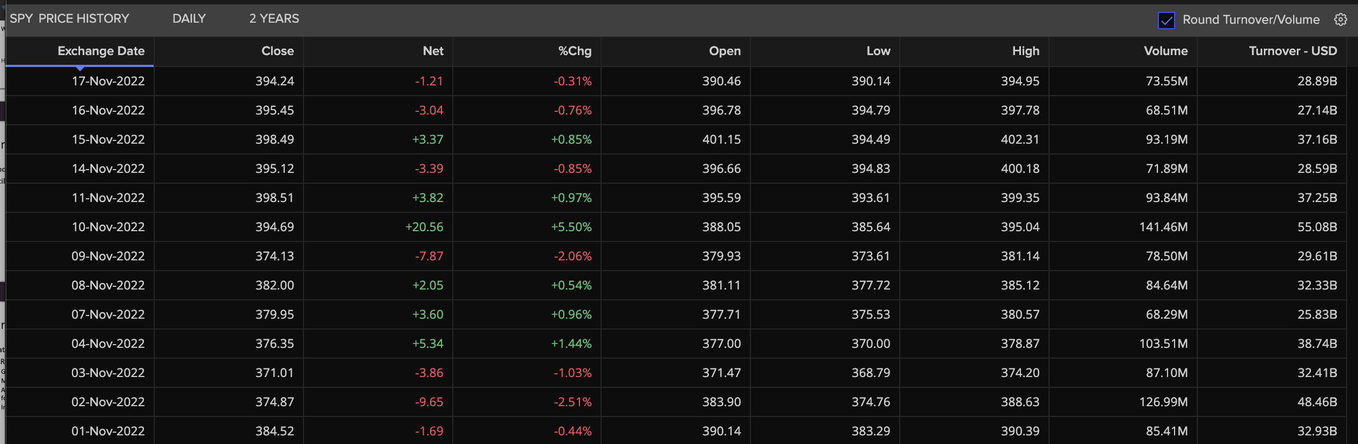
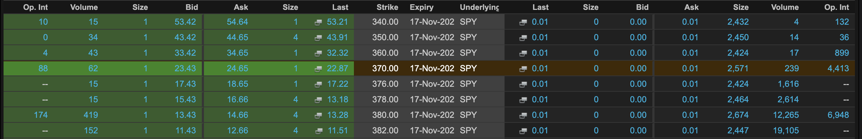
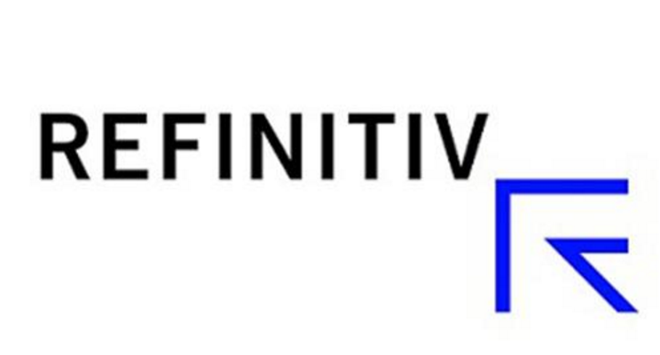
Data
SPY Price History
SPY Option Chains
Notes:
What Data will we use for our Model
Why SPY on Refinitiv
We need to have high volume/liquidity as for our HARQ model we need to utilize interday data to compute predicted Realized Volatility
We also need Data on option Chains
Both of these Data Sources can be found on Refinitiv
Other Data Sources for Volume and Risk-Free Rates can also be accessed via the API

